Slide 1
Azure IaaS
José Fehse - MVP

Slide 2
Agenda
Your services and Azure
Virtual Machines
Virtual Networks
Azure Resource Manager

Slide 3
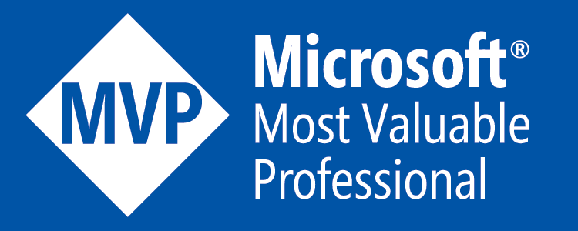
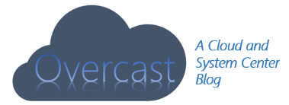
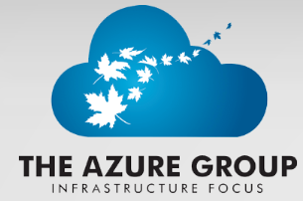
Jose Fehse
Twitter: @overcastinfo
info@overcast.info
http://overcast.info
http://tagif.ca

Slide 4
Your service
Notes:
Slide Objectives:
Explain how Azure helps developers to refocus on their applications.
Speaker Notes:
Before we discuss about specifics, let’s refocus on what you care about – your application/service.
Azure is taking a application-centric approach and brings tools and services to support DevOps scenarios.

Slide 5
→ Your application code
→ Your infrastructure code
→ Required resources
Notes:
Slide Objectives:
Explain application is made up by application code and infrastructure code.
Speaker Notes:
Let’s start with something that you know inside-and-out: your application code. [click]
Then, for whatever reason, you decide to deploy your application to Azure. [click]
What you do is to allocate a bunch of related resources out of the humongous resource pool provided by Azure, deploy your application code to these resources, and you have a running service. [click]
For DevOps’ perspective, you need a way to reliable capture and apply your requirements on resources, which can be referred as infrastructure code.

Slide 6

You: Code (application, infrastructure)
Azure: Resources (IaaS, PaaS, SaaS)
Notes:
Slide Objectives:
Reiterate the point that to make your service successful, you are partnering with Azure. You bring the code, and Azure brings resources.
This slide also sets state for the talk by explaining how IaaS components fit into the overall picture.
Speaker Notes:
[Continue with previous slide]
To make your service successful, you are partnering with Azure. You bring the code, and Azure brings resources. [Click]
And you keep iterating and making improvements over time. [Click]
In terms of infrastructure code, you can use it to define desired states of required resources (Note: current Azure Resource Manager only support a small number of Resource Providers). [Click]
You can define hosting environments, such as websites, cloud services and VMs. [Click]
Required services. [Click]
In this session we’ll focus on infrastructural components including virtual machines and virtual networks.

Slide 7
Virtual Machines

Slide 8
Azure Virtual Machines
Launch Windows Server and Linux in minutes
Scale from 1 to 1000s of VM Instances
Save money with per-minute billing
Open and extensible
Notes:
Slide Objectives:
High-level selling points of virtual machines.
Speaker Notes:
Both Linux and Windows are supported. It’s important to reiterate on this as many developers are still not aware of this.
Mention scaling at enterprise level using DSC, Puppet or Chef.
Emphasize on the openness – we are not forcing your to lock on Microsoft technologies. Instead, Azure is more open than ever. You can leverage your existing skills, tools and services, and Azure is providing more and more first-class supports for them.

Slide 9


Provisioning VM
Getting Started
Select Image and VM Size
New Disk Persisted in Storage
Windows Server
Management Portals
Boot VM from New Disk
Linux
>_
General Purpose
Basic
Standard
Optimized Compute
Performance Optimized
Network Optimized
Scripting
(Windows, Linux and Mac)
Cloud
REST API
Notes:
Slide Objective:
Explain workflow for provisioning VMs in the cloud
Speaker Notes:
You have three methods of starting this process: Build a VM from the portal, from the command line OR programmatically calling the REST API.
Once your choice of provisioning is made you will need to select the image and instance size to start from.
The newly created disk will be stored in blob storage and your machine will boot.

Slide 10
New ways to create VMs
Visual Studio – Resource Manager Templates
Azure Automation
Azure Website – Git Hub

Slide 11






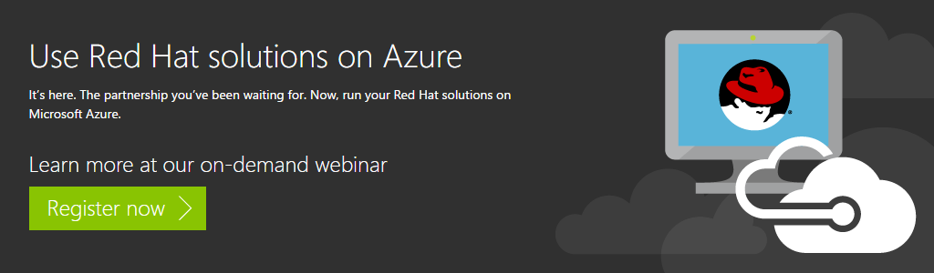











VM Gallery
A collection of prebuilt images for various workloads
Windows Server 2012 R2
Ubuntu Server 14.04 LTS
CentOS 6.5
SUSE Linux
Enterprise Server
openSUSE 13.1
Oracle Linux 6.4.0.0.0
SQL Server 2014 Standard
Oracle Database 11g R2
SharePoint Server Farm
Microsoft Dynamics
GP 2013
Zulu 8
BizTalk Server 2013
SAP HANA
Developer Edition
Puppet Enterprise 3.2.3
Barracuda Web Application
Oracle WebLogic
Server 12.1.2
Visual Studio Ultimate 2013
Windows 8.1 Enterprise
Notes:
Slide Objective:
Explain a wide variety of images that you can choose from.
Speaker Notes:
First of all, you can choose from different Windows Servers and a variety of Linux implementations. [Click]
As well as pre-built images for different flavors of SQL Database and Oracle databases. [Click]
You can also choose from a number of first-party and certified third-party images for various application servers and infrastructural components. [Click]
And last but not least, if you are a MSDN subscriber, you also have access to Visual Studio images and client Windows systems such as Windows 7 and Windows 8.1 for your DevTest purposes.

Slide 12
Virtual Machine Sizes
General Purpose compute: Basic
General Purpose compute: Standard
Optimized Compute
Performance Optimized
Network Optimized
Notes:
Slide Objective:
Introduce different virtual machine sizes.
Speaker Notes:
http://azure.microsoft.com/en-us/pricing/details/virtual-machines/

Slide 13
General Purpose Compute
Multiple Tiers
Tier | Instance | Cores | Ram | Disks | Features
Basic | A0-A4 | 1-8 | 0.75 to 14 Gb | 20-40 Gb | Economy, No Auto Scaling, no Load balancing
Standard | A0-A3 | 1-4 | 0.75 to 7 Gb | 20-285 Gb | All VM features and configurations
Standard | A4-A7 | 2-8 | 14-56 | 135-605 Gb | All VM features and configurations
Standard | A8-A9 | 8,16 | 56,112 | 382 Gb | Infiniband, RDMA. Clustering, Video encoding
Optimized Compute (D Tier) | D1-D4, D11-D14 | 1-16 | 3.5 - 112 | 50-800 Gb | 60% faster CPUs, more memory, and local SSD
Performance Optimized Compute (G Tier) | G1-G5 | 2-32 | 28-448 | 384Gb-6.1Tb | Unparalleled computational performance with latest CPUs, more memory, and more local SSD

Slide 14
Demo: Managing VMs using the Azure portal
Notes:
Demo: Provisioning VM
Prerequisites:
A Windows Server 2012 is already provisioned.
Steps:
Open Ibiza portal and click the NEW button at the lower-left corner.
Show the short list of resources. Explain that I can directly create popular resources here such as a Windows Server 2012.
Click on the Everything link.
In Gallery blade, open the Virtual machines category.
Scroll down the view and show images of different types (refer back to slide 9).
Click on Windows Server 2012 R2, and then click the Create button in the overview blade. For non-Microsoft focused audience, consider to pick a Linux image instead.
Fill in the Create VM form and click on the Create button to provision the VM. Explain this will take a few minutes.
Open the already provisioned VM.
Scroll down the blade to show various of information available on the blade.
Click on the Extensions tile.
On the Extensions blade, click on the ADD icon to bring up the extension list. Introduce that VM extensions are installable components to customize VM instances.
Switch to slides to continue with VM extension introduction.

Slide 15

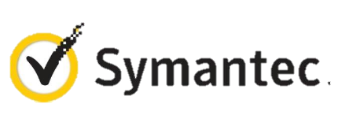


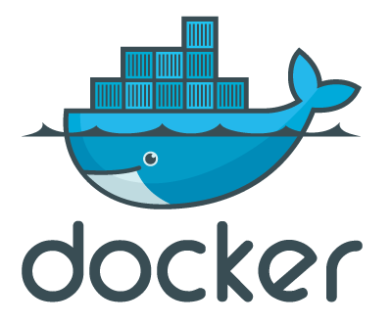

VM Extensions
Installable components to customize VM instances
Enable various DevOps scenarios
Can be added, updated, disabled or removed at any time
Managed via portal, PowerShell and Management APIs
Microsoft Azure
Notes:
Slide Objective:
Introduce VM extensions.
Speaker Notes:
No matter how big the image gallery is, your projects may have specific needs that can’t be satisfied by standard images.
Some components such as anti-virus, configuration management agents are required on most machines for compliance and management purposes.
This allows use to innovate faster to meet with your project needs. And you have flexibility to pick and combine extensions for your goals.
Point out some of existing extensions:
Custom Script Extension, which allows you to download and execute PowerShell scripts.
Chef Extension and Puppet Extension for automated management at scale.
Symantec Endpoint Protection etc. for protection.
Docker (Linux only).
Visual Studio Remote Debugger.

Slide 16
Demo: Add an extension to a VM instance
Notes:
Demo: VM Extension
Prerequisites:
Azure PowerShell v0.8 or higher has been installed and configured.
Desired Azure subscription has already been selected.
A storage account has been provisioned under the same Azure subscription.
A scripts container has been created under the storage account with public read access.
A helloworld.ps1 PowerShell script has been uploaded to the container. The content of the script is a single line: write-output “Hello World!”
PowerShell environment has been set with large font for easy reading.
A Windows Server 2012 VM has been provisioned.
Steps:
In Azure PowerShell, issue command: Get-AzureVMAvailableExtension | Format-Table -Property ExtensionName, Publisher
The above cmdlet lists existing extensions. Next we’ll see how we can inject an extension to a running VM instance. In the last demo you’ve seen that you can achieve this using Azure Management Portal. Here we’ll do it using PowerShell. In this case, we’ll install Custom Script Extension to an existing Windows Server 2012 VM.
Issue the following cmdlets to get a reference to the virtual machine instance:
$serviceName = “[cloud service that hosts the VM]”
$vmName = “[name of the VM]”
$vm = Get-AzureVM –ServiceName $serviceName –Name $vmName
Next, issue command Get-AzureVMExtension –VM $vm. This lists VM extensions that are currently installed on the VM.
Use the following cmdlet to enable Custom Script Extension, and instruct it to download and execute the helloworld.ps1 (this takes about 20-30 seconds):
Set-AzureVMCustomScriptExtension -ContainerName scripts -StorageAccountName '[your storage account name]' -VM $vm -FileName ‘helloworld.ps1' -Run ‘helloworld.ps1' | Update-AzureVM -Verbose
6. Next, we’ll retrieve and display the script execution result:
$status = Get-AzureVM -ServiceName $serviceName -Name $vmName
$result = $status.ResourceExtensionStatusList.ExtensionSettingStatus.SubStatusList | Select Name, @{"Label"="Message";Expression = {$_.FormattedMessage.Message }}
$result |fl
(see screenshots in hidden slides for references)
(see this blog: http://azure.microsoft.com/blog/2014/07/15/automating-sql-server-vm-configuration-using-custom-script-extension/ for more details on Custom Script Extension)

Slide 17
Virtual Networks

Slide 18
Azure Virtual Networks
A protected private virtual network in cloud
Extend enterprise networks into Azure
Cross-premises connectivity

Slide 19
Virtual Network Scenarios
Hybrid Public/Private Cloud
Enterprise app in Microsoft Azure requiring connectivity to on-premise resources
Enterprise Identity and Access Control
Manage identity and access control with on-premise resources (on-premises Active Directory)
Monitoring and Management
Remote monitoring and trouble-shooting of resources running in Azure
Advanced Connectivity Requirements
Cloud deployments requiring IP addresses and direct connectivity across services
Microsoft Azure

Slide 20






Cross-premises Connectivity
Site-to-site
Create a secure connection between your on-premises site and your virtual network
Point-to-site
Create a secure connection via VPN to your virtual network
ExpressRouteTM
Create a private connection between Azure data centers and infrastructures on your premises or in a co-location environment.
Connect at an ExpressRoute location (Exchange Provider facility)
Direct connect via a Network Service Provider
Microsoft Azure

Slide 21
Data Persistence
Data Disks
Azure Files

Slide 22
Disks and Images
OS Images
Microsoft
Partner
User
Base OS image for new Virtual Machines
Sys-Prepped/Generalized/Read Only
Created by uploading or by capture
Disks
OS Disks
Data Disks
Writable Disks for Virtual Machines
Created during VM creation or during upload of existing VHDs.
Notes:
Slide Objective:
Explain the differences between disks and images with VMs

Slide 23
Image Mobility
On-Premises
Cloud
MyApp.vhd
Notes:
Slide Objective:
Explain the benefits of image mobility
Notes:
One of the key benefits of IaaS is flexibility and control. The Microsoft Azure solution provides the capability of not only moving VHDs TO the cloud but also allows you to copy the VHD back down and run it locally or on another cloud provider. Great for testing out production issues or any other need where you require a copy of the production server.

Slide 24
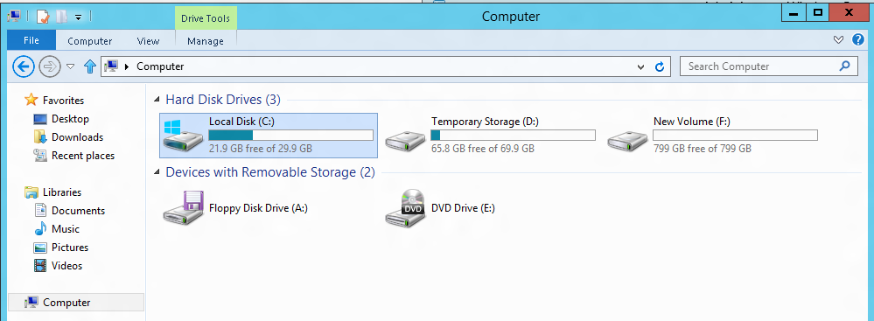
VM disk layout
OS Disk
Persistent
SATA
Drive C:
Temporary Storage Disk
Local (Not Persistent)
SATA
Drive D:
Data Disk(s)
Persistent
SCSI
Customer Defined Letter

Slide 25
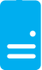
Persistent Disks and Highly Durable
Microsoft Azure Storage (Disaster Recovery)
Microsoft Azure Storage
Virtual
Machine
Virtual Machine
Notes:
Slide Objective:
Explain how disks are durable and how Microsoft Azure storage works
Notes:
The OS and Data Disks are stored in Microsoft Azure storage. So in addition to the data being persistent you also get the benefits of storage which means your VHD is replicated 3X’s locally and also 3X’s in a separate data center in the same region (geo-replication)

Slide 26
Azure Files
Shared Network File Storage for Azure
Availability, durability, scalability are managed automatically
Supports two interfaces: SMB and REST
IaaS VM
IaaS VM
IaaS VM
PaaS VM
Azure File Share
(PaaS)

Slide 27
Azure Files Scenarios
Share data across VMs and applications
Multiple writers, multiple readers using standard file system semantics.
Share settings throughout services
VMs can read settings and files from a common, shared location. These can be updated externally via REST.
Dev/Test/Debug
Very useful to have a shared location for installing applications, setting up VMs, running tools, and keeping notes while developing, testing, and debugging cloud services.

Slide 28
Azure Resource Manager

Slide 29
Azure Resource Manager Overview
Application Lifecycle Container
Available in The New Portal
Consistent Management Layer
Resources are created into a Resource Group explicitly
ARM Template (JSON)
PowerShell
Azure CLI tools
Portal
Microsoft Azure

Slide 30
Azure Resource Manager Benefits
You can deploy, manage, and monitor all of the resources for your solution as a group, rather than handling these resources individually.
You can repeatedly deploy your solution throughout the development lifecycle and have confidence your resources are deployed in a consistent state.
You can use declarative templates to define your deployment.
You can define the dependencies between resources so they are deployed in the correct order.
You can apply access control to all services in your resource group because Role-Based Access Control (RBAC) is natively integrated into the management platform.
You can apply tags to resources to logically organize all of the resources in your subscription.
You can clarify billing for your organization by viewing the rolled-up costs for the entire group or for a group of resources sharing the same tag.
Microsoft Azure

Slide 31
Management models for IaaS
Classic Model (v1)
Resource Manager (V2)
Cloud Service
Resource Group
Load Balancer w/ IP Address
Backend Pool (NICs)
VM w/ IP Address
Storage Account
VM
NIC
VM IP Address
VNet
Load Balancer
VM IP Address
Subnet
Disk (blob)
Reference
Reference
Reference
Storage Account
Virtual Network
DependsOn
Reference
Reference
Disk (blob)
Subnet-1
Network Security Group

Slide 32
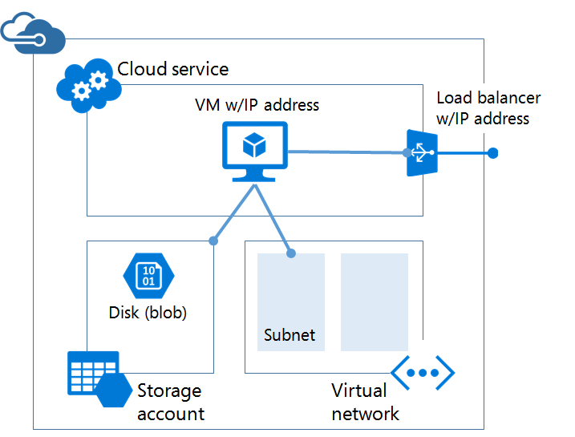
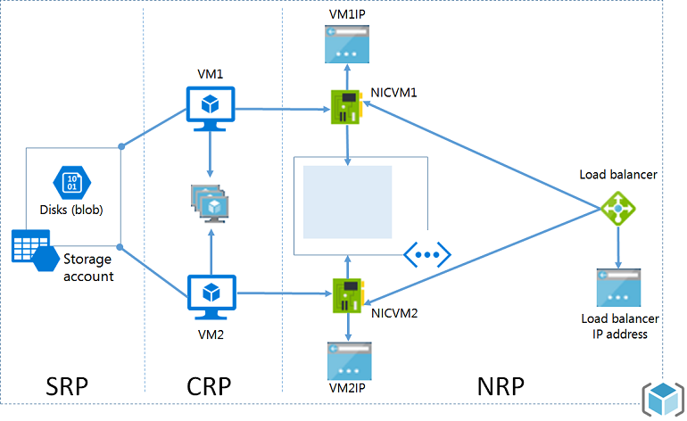
Differences

Slide 33
Azure Resource Groups
Containers of multiple Resources
Every Resource must exist in one and only one Resource Group
Unit of management
Lifecycle
Identity
Grouping
Microsoft Azure

Slide 34
Azure Resource Manager Templates
Azure Templates can:
Ensure Idempotency
Simplify Orchestration
Provide Cross-Resource Configuration and Update Support
Azure Templates are:
Source file, checked-in
Specifies resources and dependencies (VMs, WebApps, DBs) and connections (config, LB sets)
Parametrized input/output
SQL-A
Website
Instantiation of repeatable config.
Configuration → Resource Group
[SQL CONFIG] VM (2x)
DEPENDS ON SQL
DEPENDS ON SQL
SQL - A
Website
Virtual
Machines
SQL
CONFIG
Microsoft Azure

Slide 35
ARM Demo
A simple VM as code

Slide 36
Load balancing
Load balancing
Multiple VMs share the workload via public facing endpoints
Internal Load balancing
Load balancing between VMs that don’t have public facing endpoints
Microsoft Azure
Internet
Public VIP
Customer vNet
External Load Balancer
Internal Load Balancer
Microsoft Azure
Back end
Front end

Slide 37
Traffic Manager
Load balancing
Failover
Performance
Round-Robin
Geo distribution
US West
North Europe
Microsoft Azure
North America
Europe
Notes:
Traffic Manager profiles created using the existing (non-ARM) Azure Service Management (ASM) API, tools and 'classic' portal are not available via ARM, and vice versa. Migration of profiles from ASM to ARM APIs is not currently supported, other than by deleting and re-creating the profile.
'Nested' Traffic Manager endpoints are supported via the ARM API, ARM PowerShell and ARM-mode Azure CLI. They are not currently supported in the Azure portal (which also uses the ARM API).
Traffic Manager endpoints of type 'AzureEndpoints', when referencing a Web App, can only reference the default (production) Web App slot. Custom slots are not yet supported. As a workaround, custom slots can be configured using the 'ExternalEndpoints' type.

Slide 38
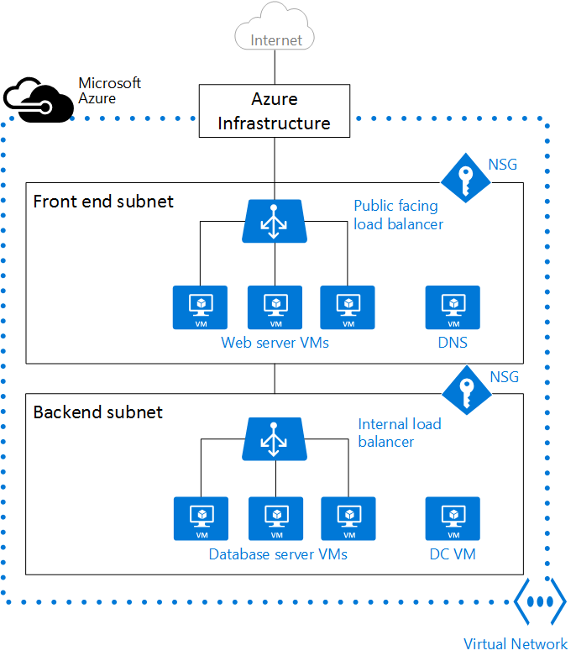
Network Security Groups
Access control List (ACL) rules that allow\deny network traffic to your VM instances in a Virtual Network.
Can be associated with either subnets or individual VM instances within that subnet

Slide 39
ARM Demo – Load balancer
Load Balancer
Networking
VM Extensions

Slide 40
What are Virtual Machine Scale Sets?
A way to deploy and manage VMs as a set
Integrated with Azure Autoscale
Integrated with Azure Load Balancer
An Azure Compute resource Microsoft.Compute/virtualMachineScaleSets
A scalable compute platform
A platform independent infrastructure for PaaS
Base OS Image
Scalable VM
Scalable VM
Scalable VM
Scalable VM
Scalable Virtual Machine
Extension 1
Extension 1
Agent
Extension 1
Extension 2
Agent
Extension 1
Extension 2
Agent
Extension 1
Agent
Extension 2
OS Image Diff
Agent
Extension 2
OS Image Diff
Extension 2
OS Image Diff
OS Image Diff
OS Image Diff Disk
Notes:
Pets vs Pack – cattle.

Slide 41
ARM Demo 2 – Scale Sets

Slide 42
Fault and Update Domains
Fault Domain
Fault Domain
Rack
Rack
Web Role
UD #1
UD #2
INSTANCE
INSTANCE
INSTANCE
INSTANCE
Worker Role
UD #1
UD #2
INSTANCE
INSTANCE
INSTANCE
INSTANCE
Notes:
Slide Objective:
Provide a graphical view of fault and upgrade domains for existing web and worker roles. Use to contrast existing skills with availability sets.
Notes:
You can see that our service is well spread out across both fault and upgrade domains
The loss of a fault domain will not cause a failure of our service nor will the restart or change of an upgrade domain cause a failure of our service
Notes
Useful pre-reading here.
http://blog.toddysm.com/2010/04/upgrade-domains-and-fault-domains-in-windows-azure.html

Slide 43
Virtual Machine Availability Sets
Update Domains are honored by host OS updates
Fault Domain
Fault Domain
Rack
Rack
Availability Set
Virtual Machine
Virtual Machine
IIS1
IIS2
UD #1
UD #2
Availability Set
Virtual Machine
Virtual Machine
SQL1
SQL2
UD #1
UD #2
Notes:
Slide Objective:
Explain availability sets
Notes:
Availability sets tell the Fabric Controller to place VMs in the same set on different racks for faults and in separate upgrade domains for updates.
This essentially tells the FC not to take the guest OS down of all VMs in the same set for host updates.

Slide 44
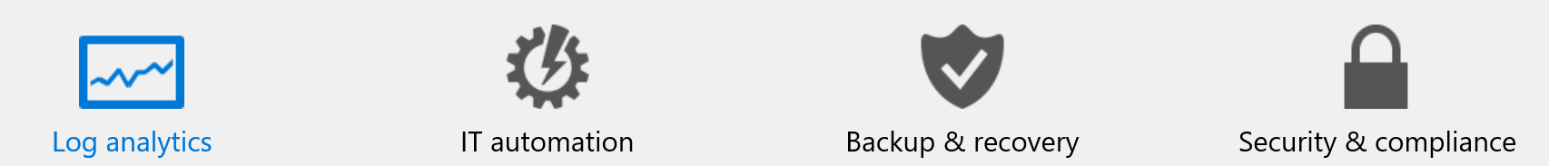
Management
Operations Management Suite
Diagnostics
Remediation

Slide 45
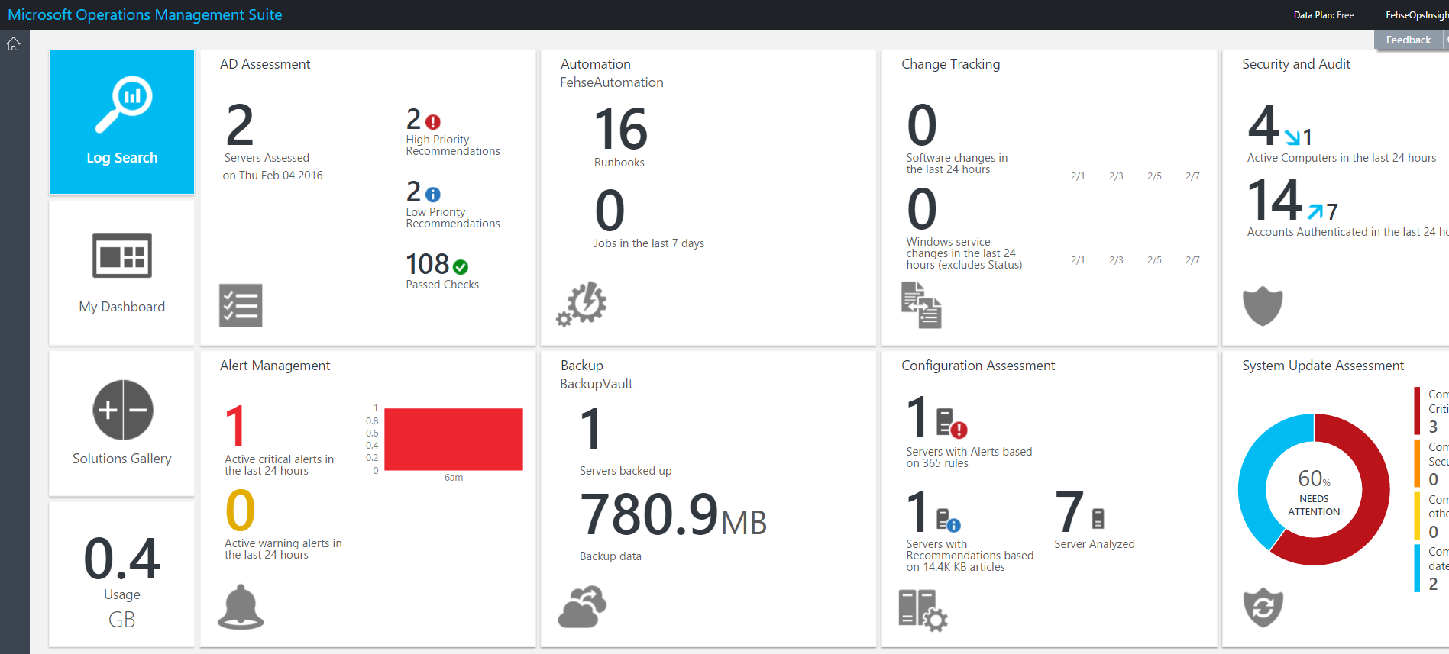
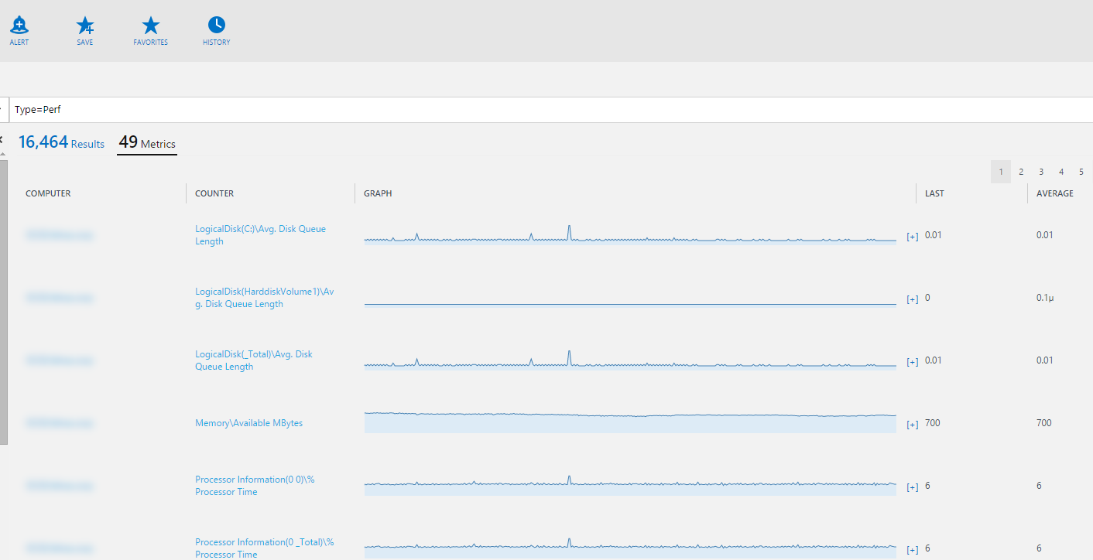
Log Analytics

Slide 46
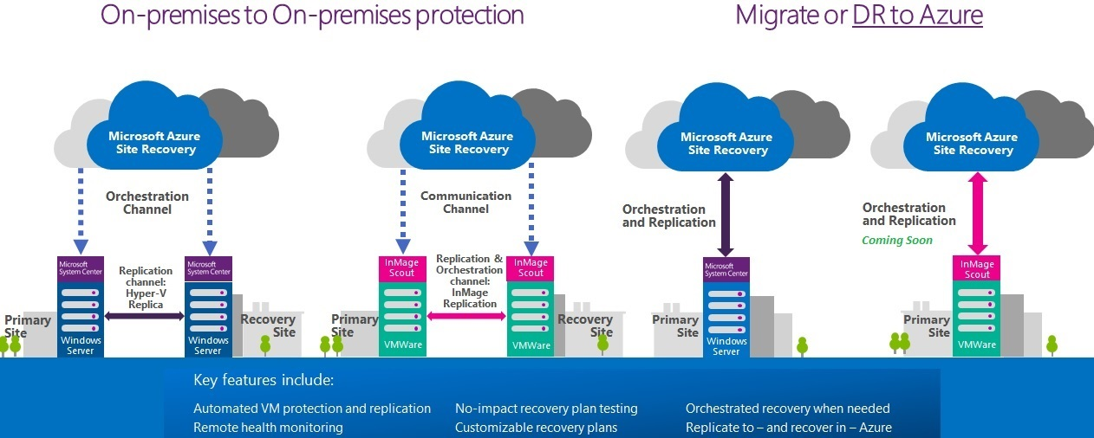
Azure Site Recovery

Slide 47

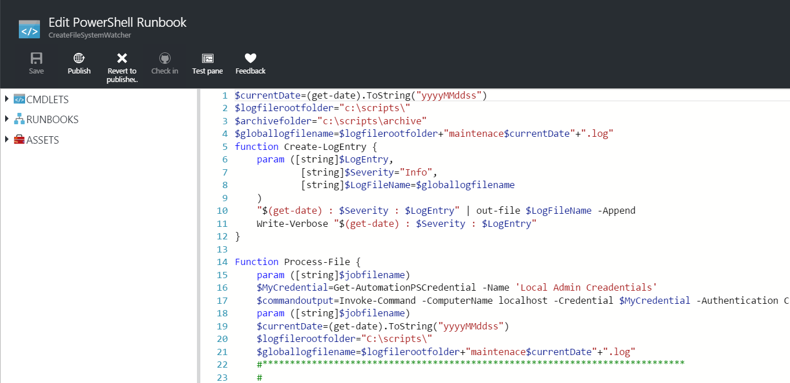
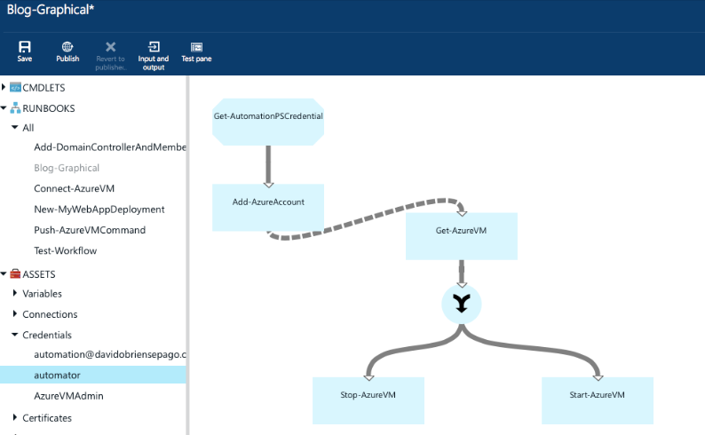
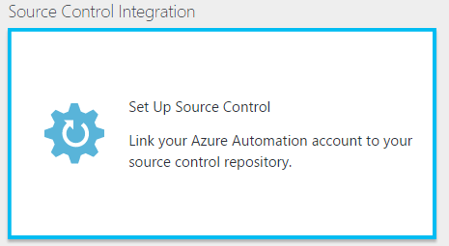
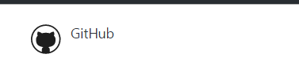
Automation

Slide 48

Try Microsoft Azure today
Ask Questions:
Twitter: @overcastinfo
info@overcast.info
http://overcast.info
http://tagif.ca
http://newsignature.com

Slide 49
Q&A
https://github.com/josefehse/LetsCloudThisToronto

Slide 50


Get started
Visit azure.microsoft.com

Slide 52
Virtual Machine Availability
SLAs
Fault domains, update domains and availability sets

Slide 53
Meaning of 9’s
Service Availability(%) | System Type | Annualized Down Minutes | Quarterly Down Minutes | Monthly Down Minutes | Practical Meaning | FAA rating
90 | Unmanaged | 52,596.00 | 13,149.00 | 4,383.00 | Down 5 weeks per year
99 | Managed | 5,259.60 | 1,314.90 | 438.30 | Down 4 days per year | ROUTINE
99.9 | Well managed | 525.96 | 131.49 | 43.83 | Down 9 hours per year | ESSENTIAL
99.99 | Fault tolerant | 52.60 | 13.15 | 4.38 | Down 1 hour per year
From Generic Requirements for Operation Systems Platform Reliability, Telcordia Technologies System Documentation,GR-2841-CORE and
Federation Aviation Administration Handbook: Reliability, Maintainability, and Availability (RMA) Handbook, FAA-HDBK-006A, Jan 7, 2008.
Microsoft Azure

Slide 54
Meaning of 9’s
Service Availability(%) | System Type | Annualized Down Minutes | Quarterly Down Minutes | Monthly Down Minutes | Practical Meaning | FAA rating
99.999 | High availability | 5.26 | 1.31 | 0.44 | Down 5 minutes per year | CRITICAL
99.9999 | Very high availability | 0.53 | 0.13 | 0.04 | Down 30 seconds per year
99.99999 | Ultra availability | 0.05 | 0.01 | - | Down 3 seconds per year | SAFETY CRITICAL
From Generic Requirements for Operation Systems Platform Reliability, Telcordia Technologies System Documentation,GR-2841-CORE and
Federation Aviation Administration Handbook: Reliability, Maintainability, and Availability (RMA) Handbook, FAA-HDBK-006A, Jan 7, 2008.
Microsoft Azure

Slide 55

Service Level Agreements
99.95% for multiple role instances
4.38 hours of downtime per year
What’s included
Compute Hardware failure (disk, CPU, memory)
Datacenter failures - Network failure, power failure
Hardware upgrades, Software maintenance – Host OS Updates
What is not included
VM Container crashes, Guest OS Updates

